Slide 1

Research Report on Raymond Ltd.

Slide 2
Raymond Ltd :-
Raymond Ltd is a diversified Indian holding company that is primarily engaged in the business of fabrics, suiting and shirting, denim, and apparel for men and women. It was founded by AJ Raymond in 1925 and is headquartered in Mumbai, India. The Company has a retail network of 1,638 stores, including 1,589 stores in about 600 towns and cities in India and 49 overseas stores in nine countries.
The company has several subsidiaries, including Raymond Apparel Limited, ColorPlus Fashions Private Limited, JK Helene Curtis Limited, and Park Avenue Fashions Limited.
The Company is run by Gautam Vijaypat Singhania and the promoters hold- 49.15% of the shareholding and the large part of shares is held by Public -29.58%,FIIs -16.28%,DIIs- 4.97%. Sunil Kataria is the CEO of the company.
The business model of the company is B2B as it operates through four business segments: Textile, Apparel, Retail, and Others.. Raymond Ltd has a strong focus on sustainability and has implemented various initiatives to reduce its environmental impact.
The sales record of the company is quite good with 4% CAGR over 5 years period FY2019-23 and growing PAT. There is a growth of 95.80% in sales ,the ROCE and ROCE have not been performing well since 2020.

Slide 3
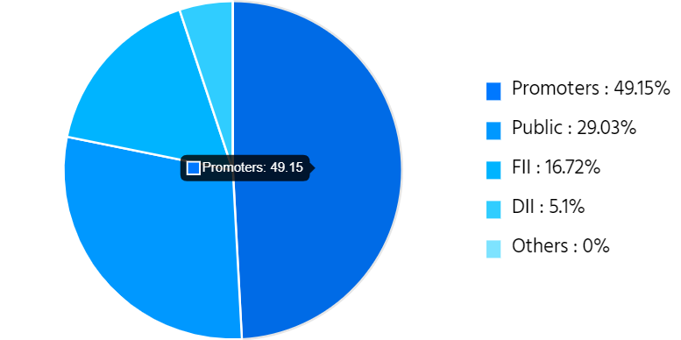
Data & Charts :- (Buy below Rs 1500)
Market Data
Sector | Textiles
CMP | 1,308.55
Market Cap | 8,706Cr
Net Debt | 1,713.26 Cr
EV | 10,190.50 Cr
52 week high/low | 1,644/737
Rating | Buy

Slide 4
The Key drivers for the company:-
Strong demand for premium product categories across suiting and shirting-The trade channel sales grew at the backdrop of strong bookings driven by product innovation that were well received by our trade partners. In addition to the strong festive demand, there was sustained demand for the office with an encouraging response to our casual wear categories by the customers.
The high value shirting segment- the sales grew by 42% to INR211 crores compared to INR148 crores in the previous year due to higher cotton fabric sales in the domestic market. The segment reported an EBITDA margin of 13.2% for the quarter as compared to 17.4% in the previous year.
Social initiative, garment exchange program in association with Kunj- which was executed across our 1,000-plus strong TRS network, the Raymond shop network, has received great response at about three lakhs pond garments were given to the lesser privileged sections of society under the close Forward program.
The branded apparel segment- which showed a very strong sales growth of 67% to INR 370 crores as compared to INR221 crores during second quarter of previous year.
Widening wardrobe Choices of the customers that are suited for different occasions- The segment reported a robust EBITDA margin of 22.3%, driven by a diversified product mix in suiting as well as shirting fabrics and enhanced operational efficiencies.
Opened 21 EBOs on a net basis-Currently, our EBO network is performing well. Our performance was driven across all brands of Park Avenue, Colas, Raymond Ready to base and PARP, which offers a plethora of options for consumers to dress up across occasions.

Slide 5
Key Investment Rationale:-
Integrated facility, everything we do in-house:- So we have got right the yarn fabric manufacturing, finishing facilities for both suiting, shirting, garmenting, we are doing the tailoring and ending it out.
Investment on Garment business:- the demonstrated performance compared to last year, we have demonstrated a 25% growth in the revenue already. India is becoming a large textile export destination as people want to move out of China, diversify their supply chain. we are evaluating a very strong expansion, which will happen over the coming years in terms of meeting this increased tie-up that we’re doing strategic customers.
Sourcing strategy and expansion plans:- we are building right now a very strong and very unique vendor base of different segments across the country. So that’s our point in terms of our sourcing strategy. In terms of our expansion plans, we are pretty much on track to right now do a 70 exclusive brand outlets this year. and that is a number that we are gunning for Netrix. We have 35 already right now.
Strong Demand:- we have been able to, in the last one year, get into very strong alignment with some of the top global brands. So in the light of the strong demand that we are seeing with strategic tie-ups happening with global brands, we are ramping up land part so that we can get them paid and make them fully skilled before they really start working on these high-quality lines.

Slide 6
Key Risk Factors:-
High skilled Workforce addition
Meet the global quality standards
Debt reduction
Focus on delivering margin
Product portfolio expansion and constant innovation.

Slide 7
Peer Comparison & Valuation:-
Name | CMP Rs. | P/E | Mar Cap Rs.Cr. | Div Yld % | NP Qtr Rs.Cr. | Qtr Profit Var % | Sales Qtr Rs.Cr. | Qtr Sales Var % | ROCE %
Raymond | 1308.25 | 12.15 | 8709.51 | 0.23 | 96.60 | -4.23 | 2168.16 | 17.62 | 13.19
Jindal Worldwide | 348.35 | 56.46 | 6985.13 | 0.03 | 14.76 | -52.03 | 403.78 | -40.24 | 19.25
Garware Tech. | 2903.25 | 35.55 | 5916.29 | 0.24 | 36.57 | -3.91 | 274.58 | -10.89 | 22.93
Go Fashion (I) | 1008.30 | 67.80 | 5445.73 | 0.00 | 24.31 | 2.62 | 176.74 | 24.46 | 11.98
Trident | 31.45 | 32.56 | 16026.78 | 1.14 | 144.21 | -37.40 | 1641.44 | -17.10 | 23.35
Welspun India | 81.15 | 66.12 | 8153.34 | 0.18 | 43.83 | -73.38 | 1869.15 | -22.70 | 14.53
Median: 42 Co. | 128.5 | 31.28 | 341.31 | 0.01 | 2.41 | -16.11 | 85.81 | -8.86 | 12.79
Swan Energy | 224.50 | 49.90 | 5924.94 | 0.04 | -15.70 | 23.64 | 101.10 | 45.93 | 0.11

